Slide 1

Getting started with Azure AI Foundry
Guy Gregory – Partner Solution Architect (Azure AI)
Notes:
Opening question – “how long before you, or your customers start ‘hiring’ AI staff members’? “how will you maximise the opportunity”?
6 point checklist, disguised as a presentation
Honestly, each one of these six slides could be a 1 hour presentation, so the onus is on you to go off and do some homework
Slides will be available at the end

Slide 2
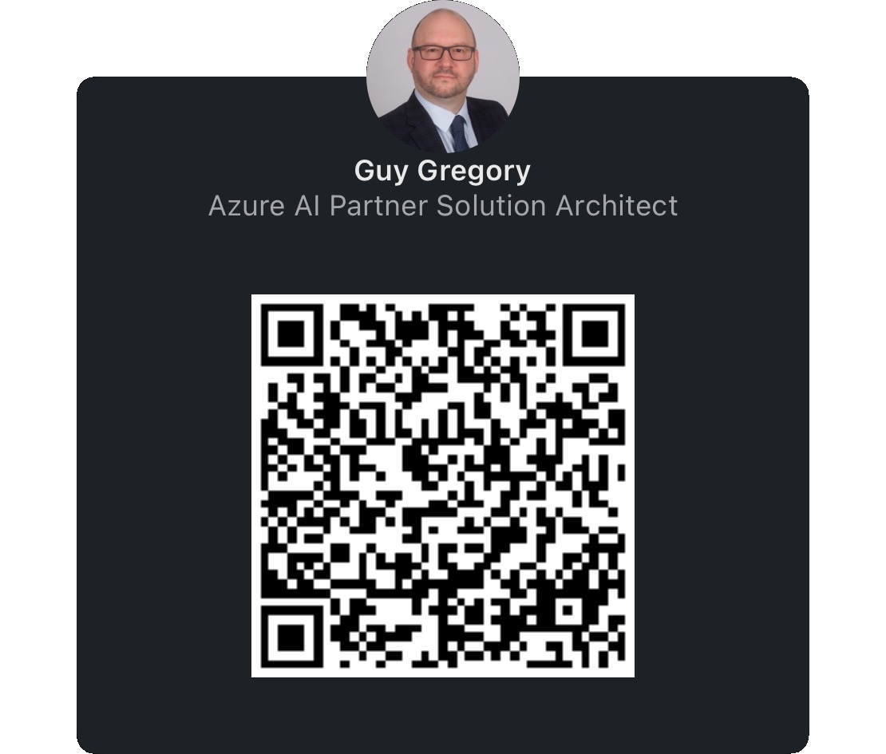
Introduction – Guy Gregory
Partner Solution Architect, EMEA Partner Team (GPS)
Aligned to Azure AI
Focus on Channel Partner
20+ years of Microsoft partner experience
Notes:
Introduction
Please feel free to connect with me on LinkedIn

Slide 3

#1 Understand the opportunity of AI in the workplace: The Journey to the Frontier Firm Partner
https://aka.ms/wti
Notes:
I want you to reach this outcome by yourself by reading
Work Trend Index
Concept of Frontier Firm
Intelligence on tap
Human-agent teams will become common
Every employee will be an agent boss
How do we take this concept of Frontier Firm, and build the Frontier Partner

Slide 4


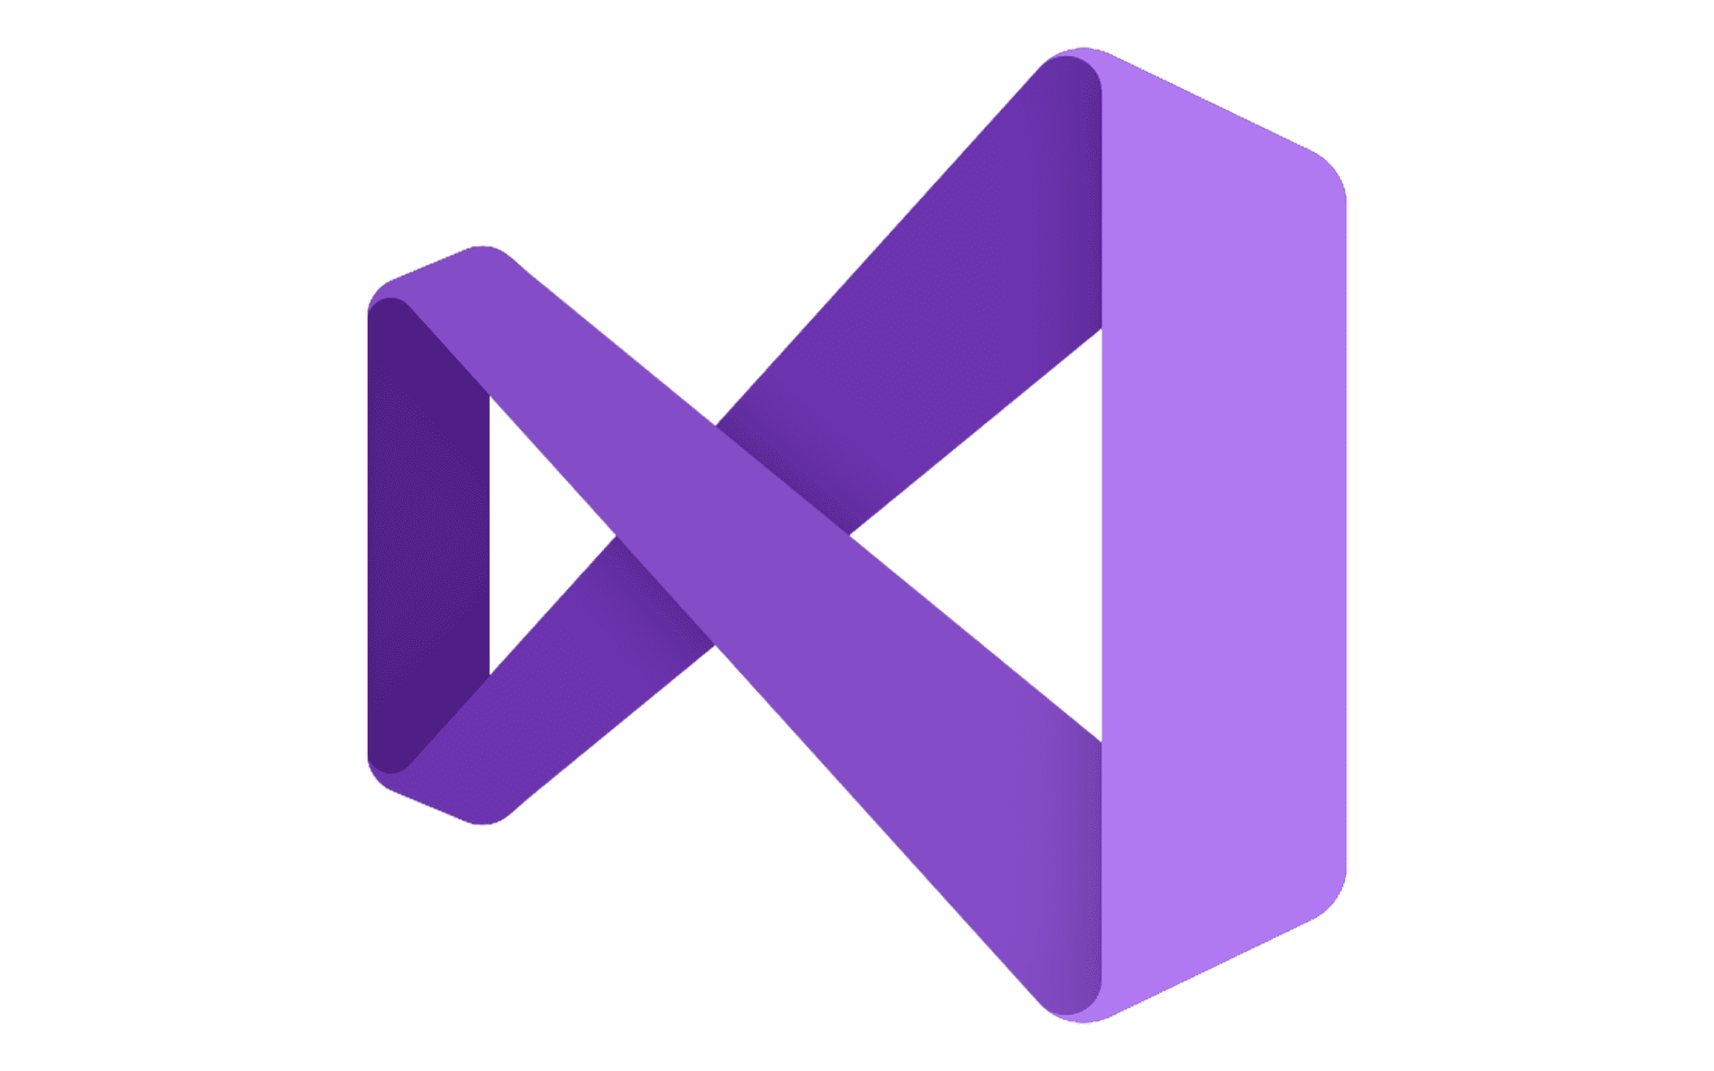


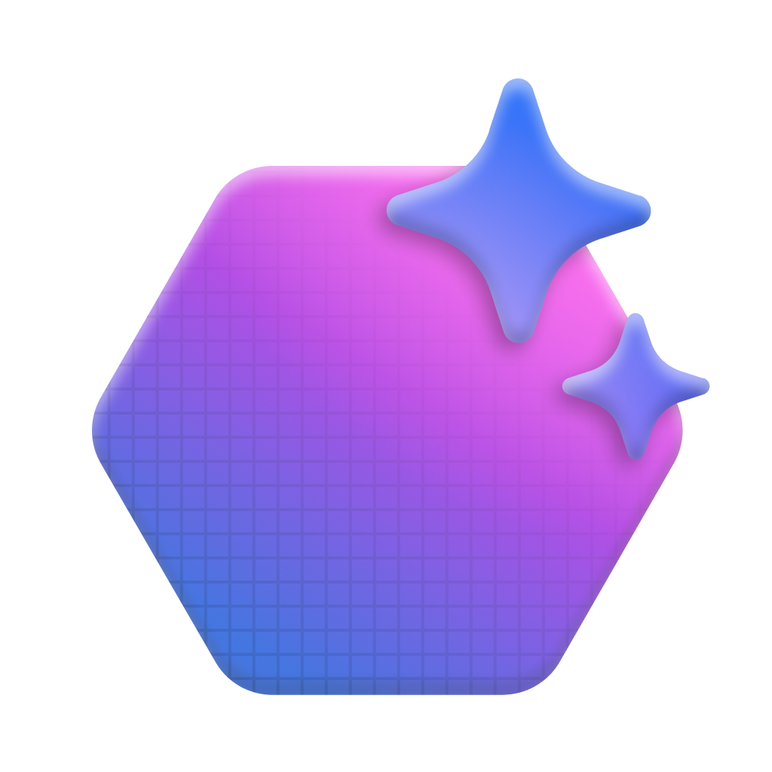



#2 Understand the business value of Azure AI Foundry
Azure AI Foundry
Model Catalog
Copilot Studio
Foundational models
Open-source models
Task models
Industry models
Visual Studio
Azure OpenAI Service
Azure AI Search
Azure AI Agent Service
Azure AI Content Safety
Azure Machine Learning
GitHub
Evaluations
Customization
Governance
Monitoring
Azure AI Foundry SDK
Observability
https://ai.azure.com
Notes:
Grounding in data using services like Azure AI Search (and also up-to-date info provided by Bing Search)
Responsible AI Approach - Protection of inputs, compliant outputs and Prompt Shielding using Azure AI Content Safety
Extensive model choice – 1,900+ models, including Azure OpenAI models, from Meta, Mistral, Cohere, and our own open-source SLM, Phi
Azure AI Agent Service – which was announced at Microsoft Ignite last November, and provides a fully managed service designed to empower partners and developers to securely build, deploy, and scale high-quality, and extensible AI agents.
Tight integration with all of the tools that developers know and love (Copilot Studio, VS Code, GitHub, Foundry SDK, frameworks like Langchain, LlamaIndex, AutoGen, SK, etc.)

Slide 5
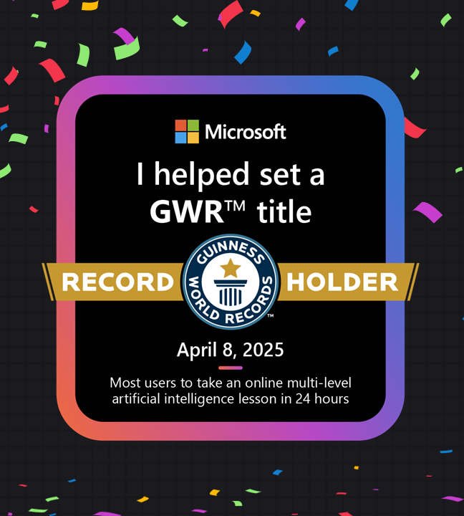
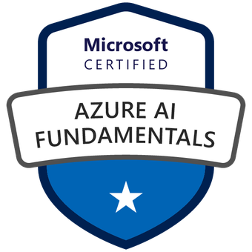


#3 Upskill your team: Join the Microsoft AI Skills Fest (April 8th - May 28th)
https://aka.ms/AISkillsFest
Notes:
Step 1 – Build an AI skills plan for your team
Microsoft are doing our bit
GUINNESS WORLD RECORDS™ title for the most users to take an online multi-level artificial intelligence lesson in 24 hours, with a total of 126,151 participants – 8th April
Still open until 28th May
50,000 Exam Vouchers – consider going for AI-900, then AI-102
Microsoft Learn
Applied Skills
Marketing co-op

Slide 6
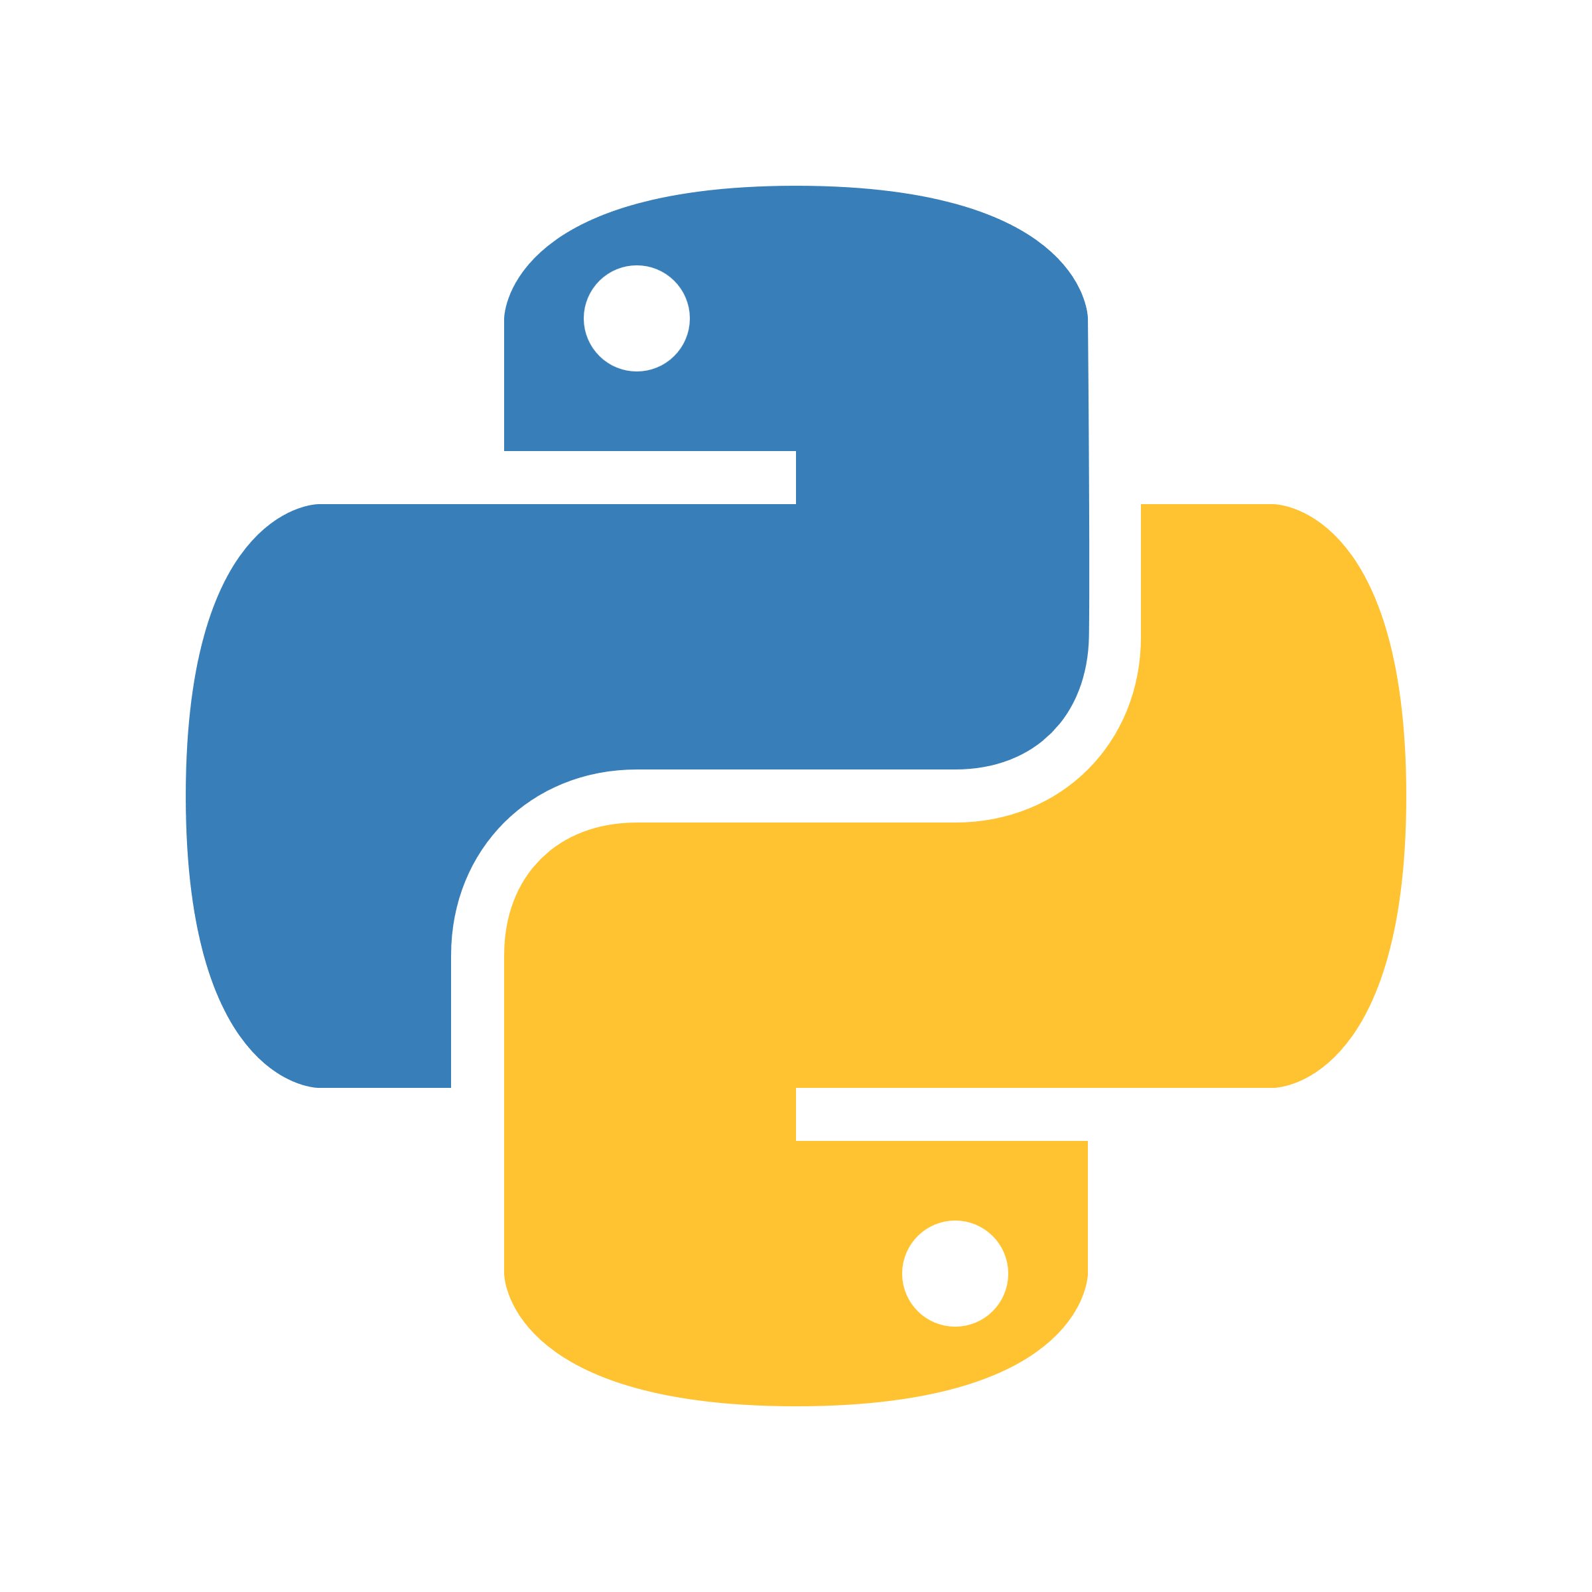
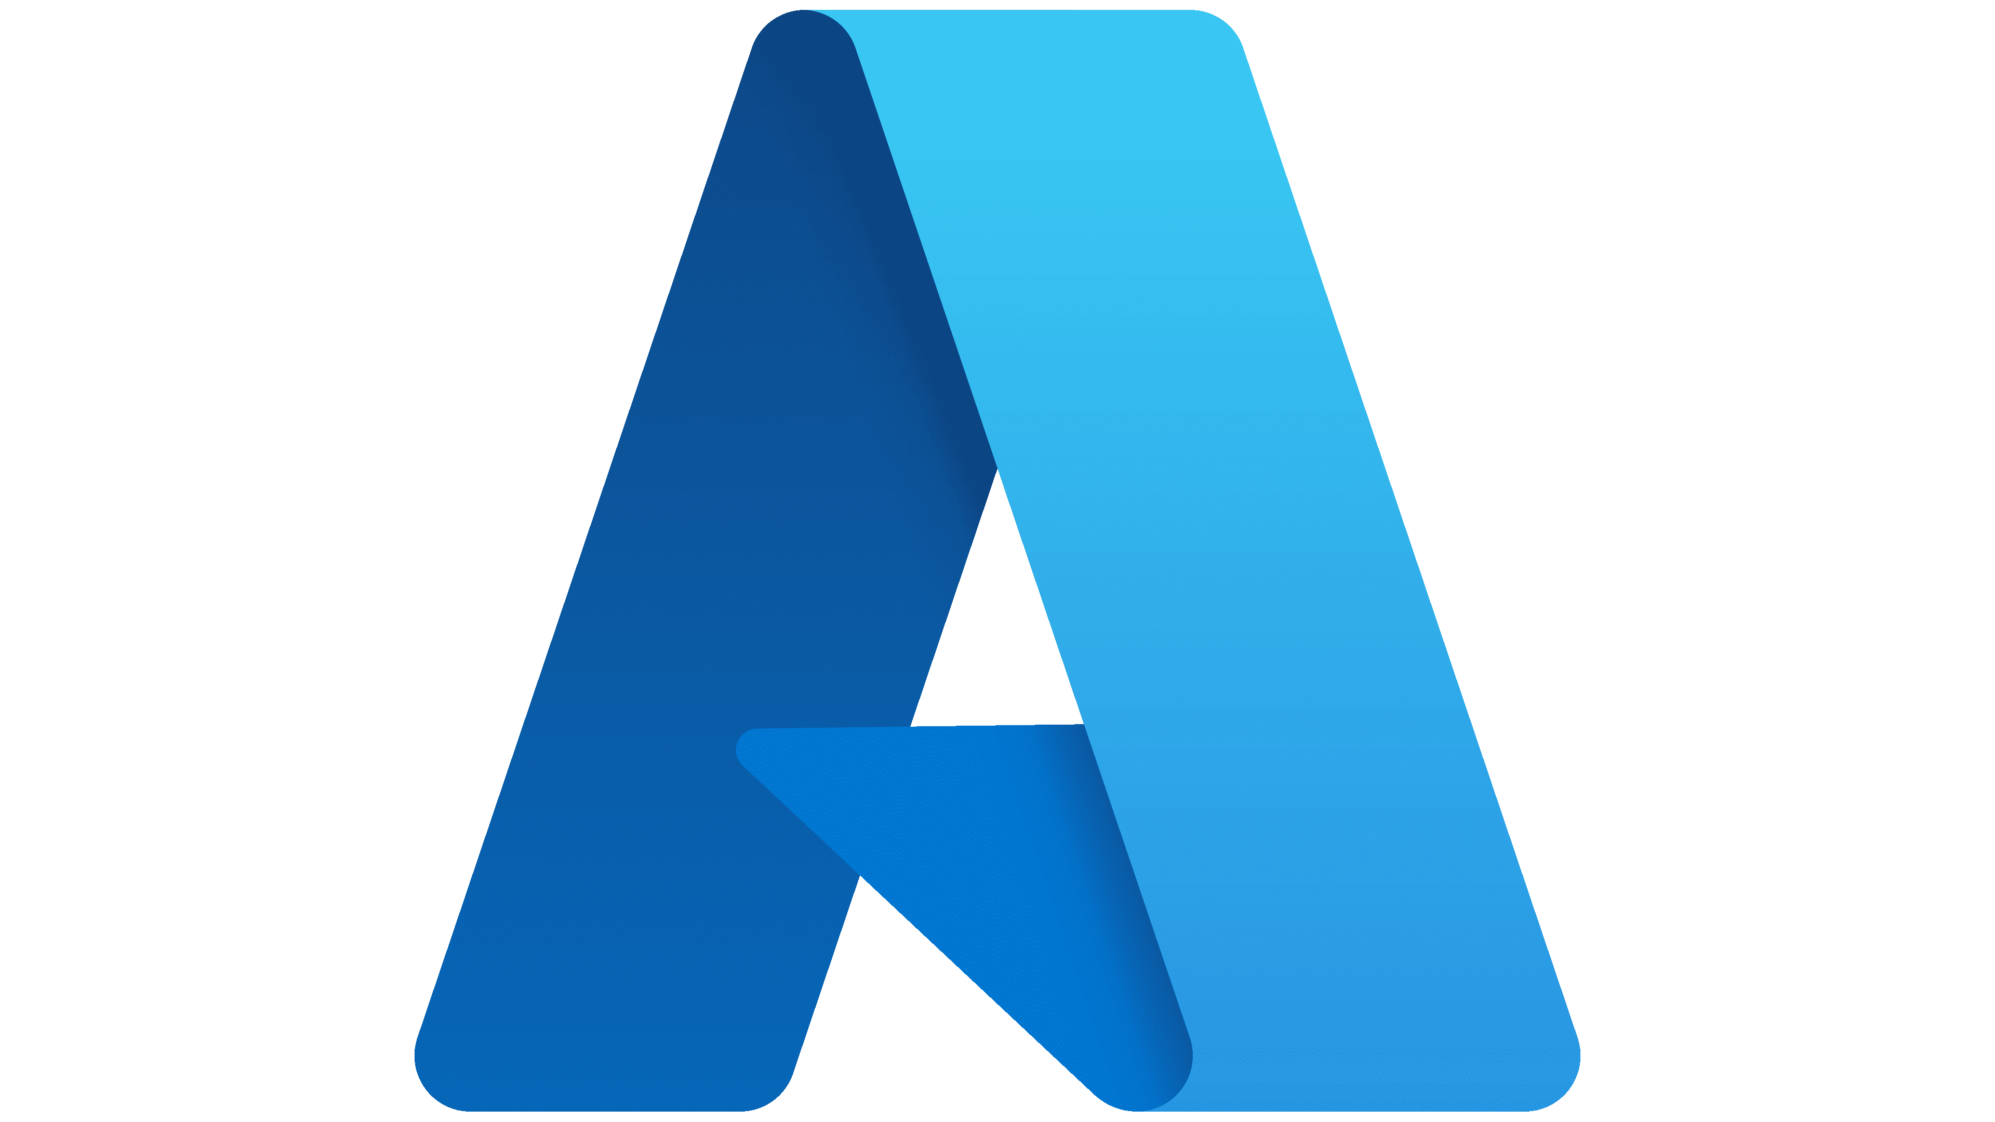


#4 Activate your product benefits from the Partner Program Enable your team
Quiz question:
How many books of AI-generated output could you produce with $700 of gpt-4o-mini output tokens?
Answer:
Approx. 10,000 books
 | Partner Launch | Partner Success Core | Partner Success Expanded | Solutions Partner | Specialized Partner
Azure bulk credit (per year) | $700 | $2,400 | $4,000 | $6,000+ | $12,000+
https://aka.ms/PartnerProgramBenefits
Notes:
Ensure you are empowering your team with the right tools:
Azure, Azure AI Foundry, VS Code, Python, and GitHub Copilot
These tools will be available to most of the partners in this room as part of their Partner Benefits
Find the person responsible for your Azure Bulk Credit, and ensure that it’s being utilised
If you don’t have access to an Azure subscription, you can get started with GitHub Models and the free tier of GitHub Copilot
Visual Studio Subscriptions
Partner Launch ($345)
Partner Success Core ($895)
Partner Success Expanded ($3,995)
Solutions Partner ($4,730)
Specialized Partner ($4,730)
Credit 700
gpt-4o mini output 0.6 dollars per million tokens
Number of tokens (M) 1166.667 millions of tokens
Number of words (M) 875 millions of words
Typical book 90,000 words
Number of books 9722.222 books

Slide 7
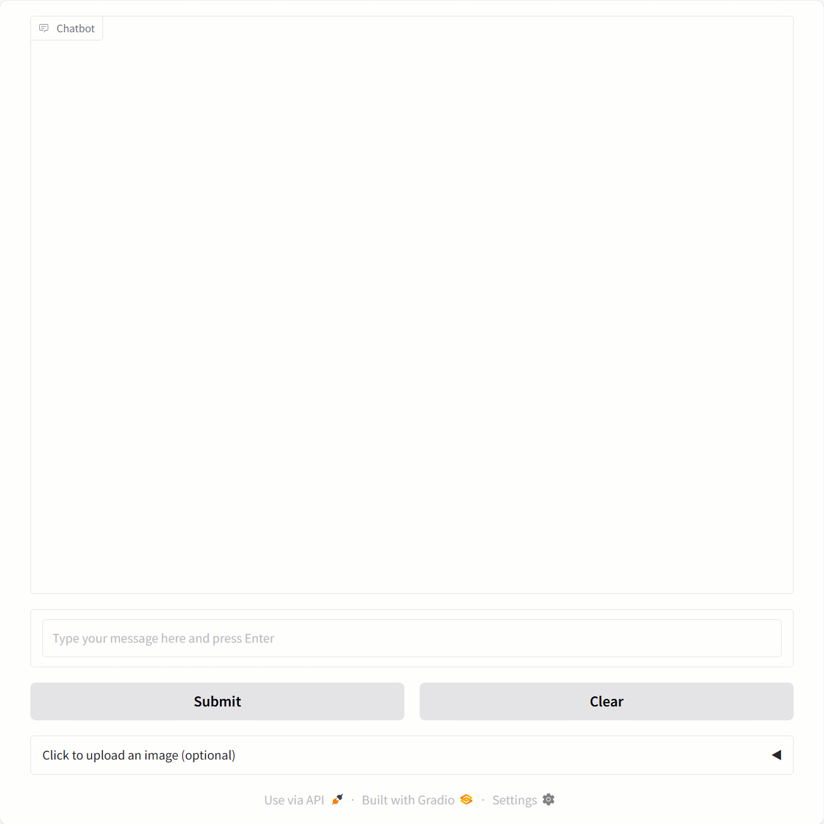
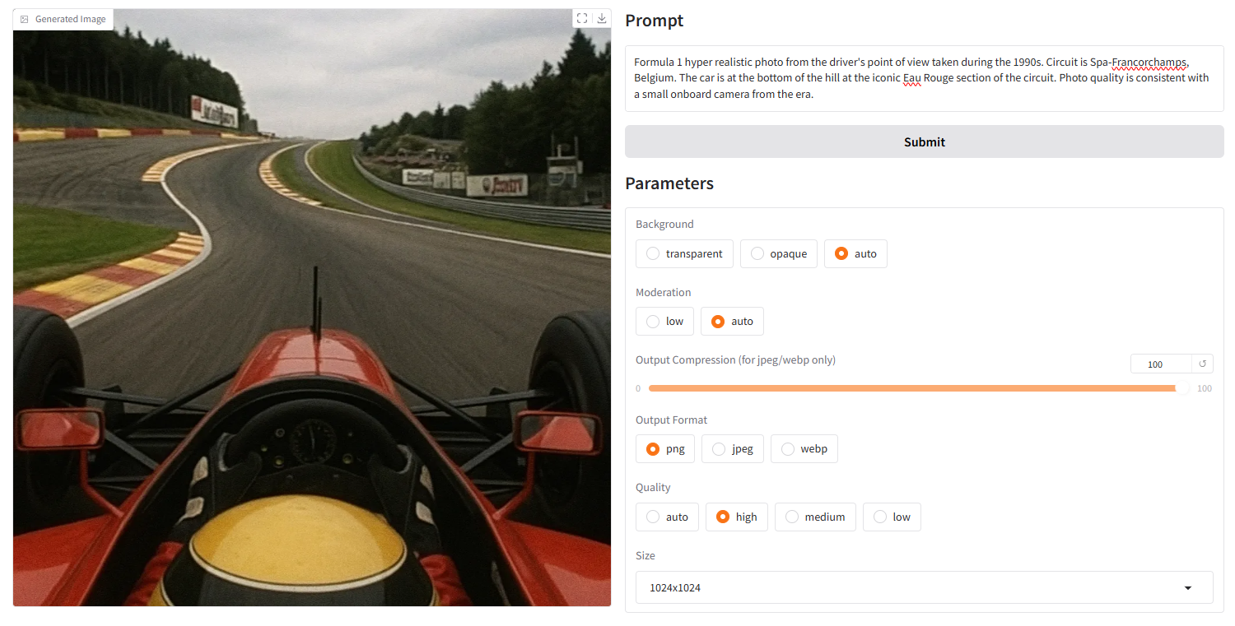
#5 Be your own customer zero Lead by example
http://aka.ms/AzureAI-Samples
Notes:
Be your own customer zero
Select one internal workflow
Show up to your customers not with slides, but with demos
Join or lead hackathon events to help customers explore the art of the possible
Don’t reinvent the wheel, start with our code samples, and build from there

Slide 8
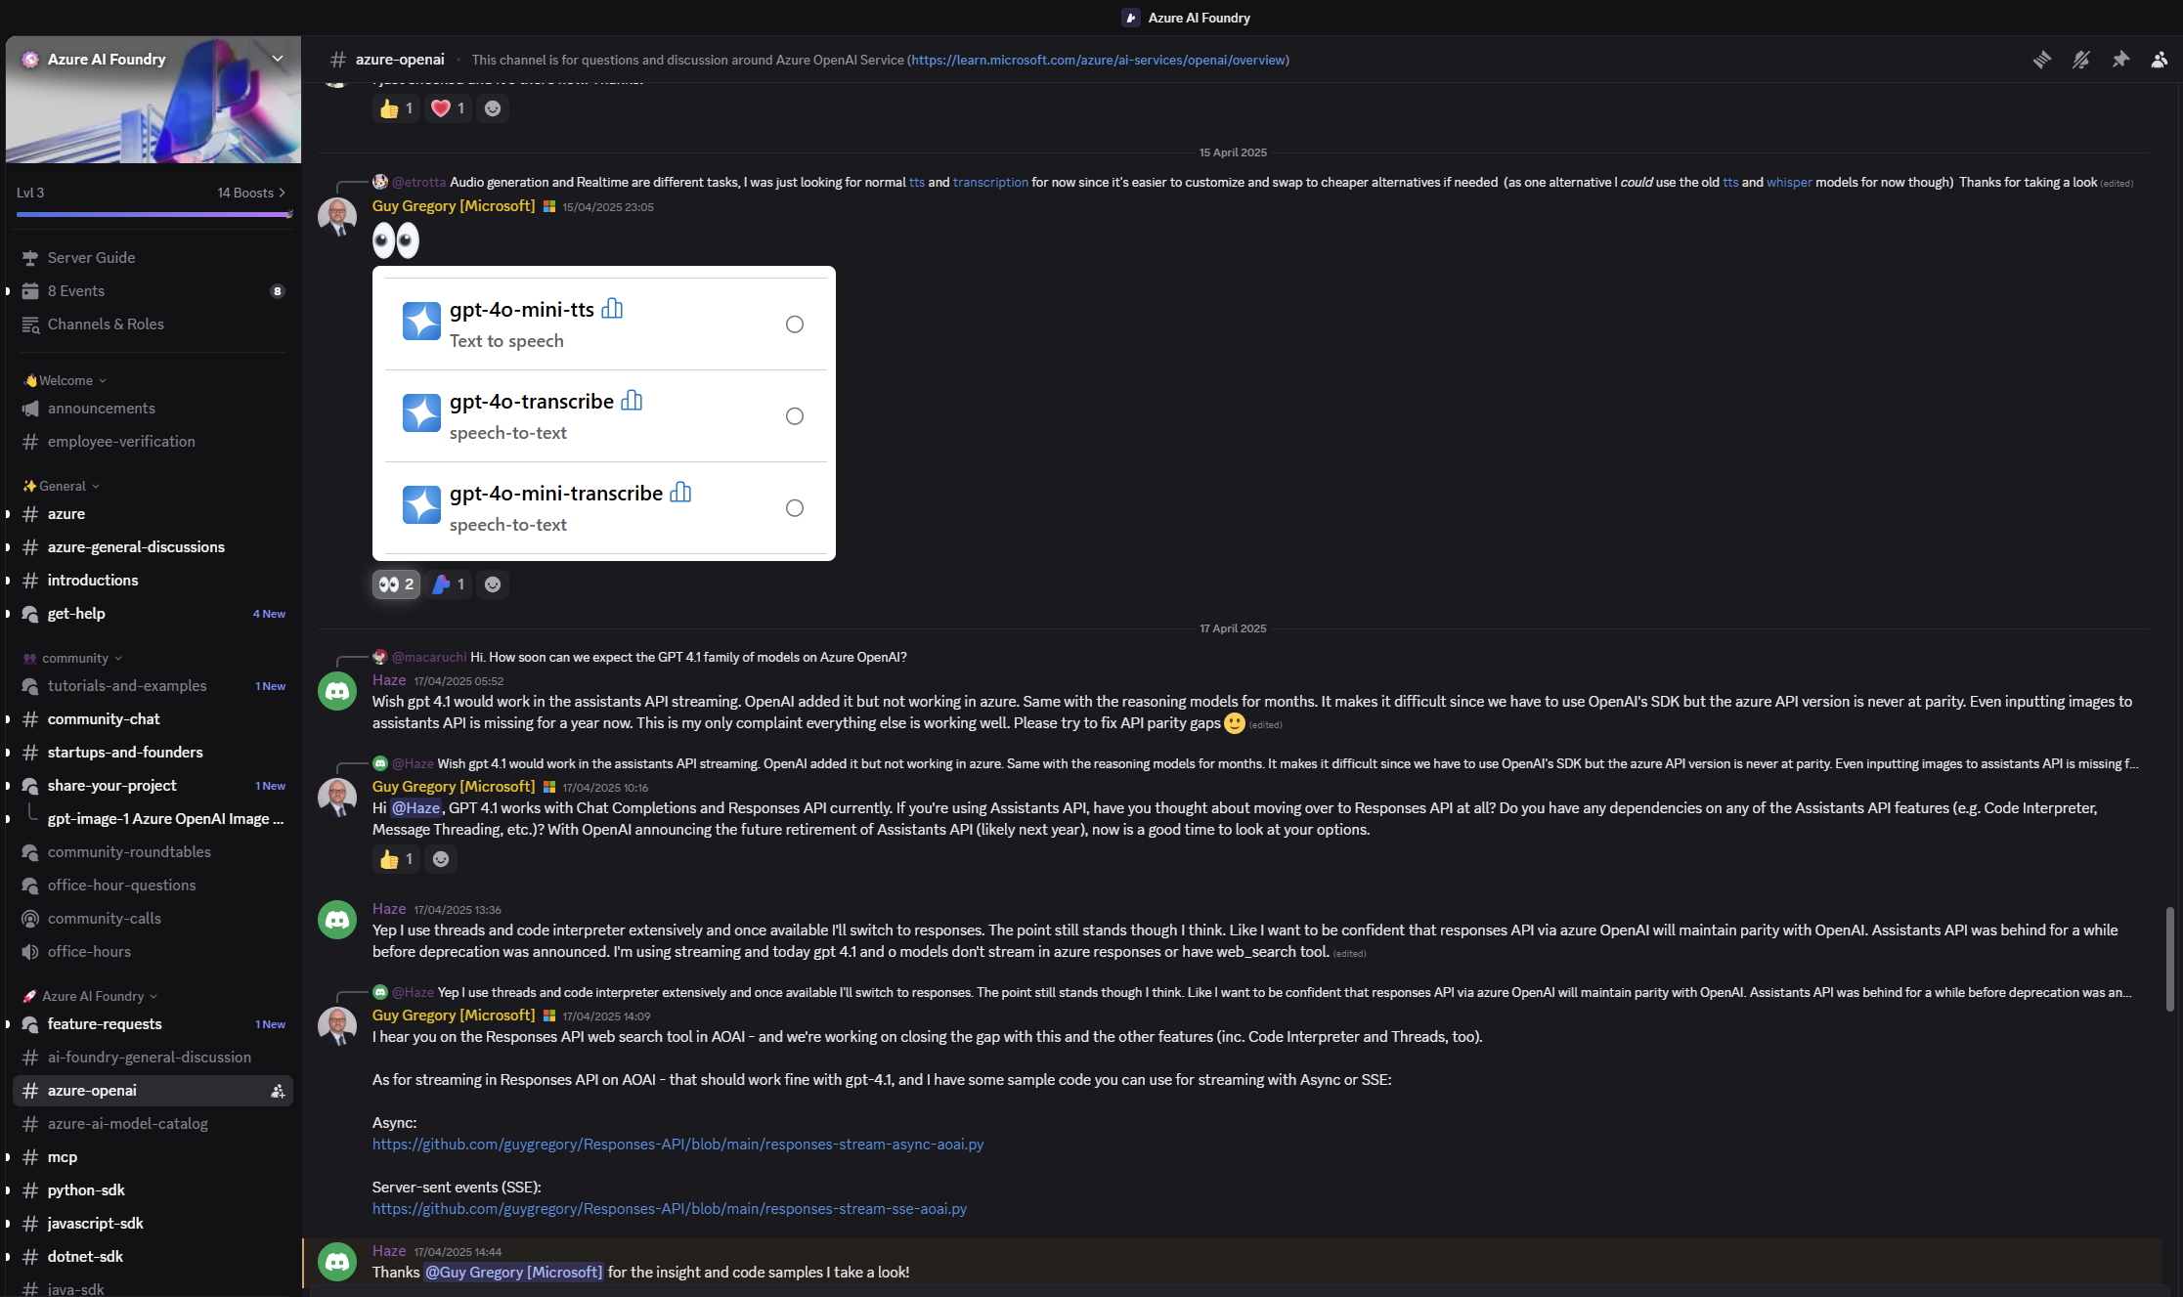
#6 Join the Global Azure AI Foundry Community Join 24,000 builders, and be part of the conversation
https://aka.ms/AzureAI/Discord
Notes:
Join the community of AI Builders
Azure AI Discord of 24,000 people
Azure AI Blog and Discussions forum on GitHub
Attend your local user group
No user group? Start one
That’s the end of my presentation, and here’s the summary of the six points

Slide 9
Actions
1
Read the 2025 Work Trend Index to learn the state of AI in the workplace: https://aka.ms/wti
2
Understand the business value of Azure AI Foundry: https://ai.azure.com
3
Upskill your team: https://aka.ms/AISkillsFest
4
Activate your product benefits from the Partner Program: https://aka.ms/PartnerProgramBenefits
5
Lead by example: http://aka.ms/AzureAI-Samples
6
Join the Global Azure AI Foundry community: https://aka.ms/AzureAI/Discord
Notes:
Here’s the homework
Feel free to take a photo
If you’d like to download a PDF of this slide deck…

Slide 10
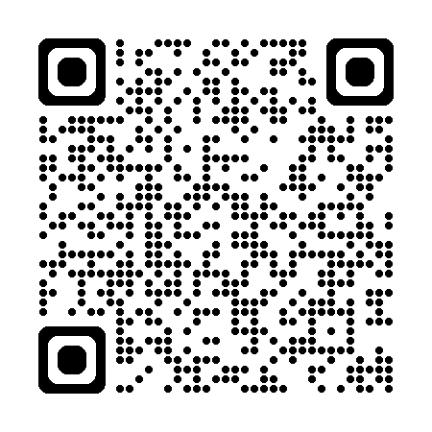
https://aka.ms/StartAzureAI

